Slide 1
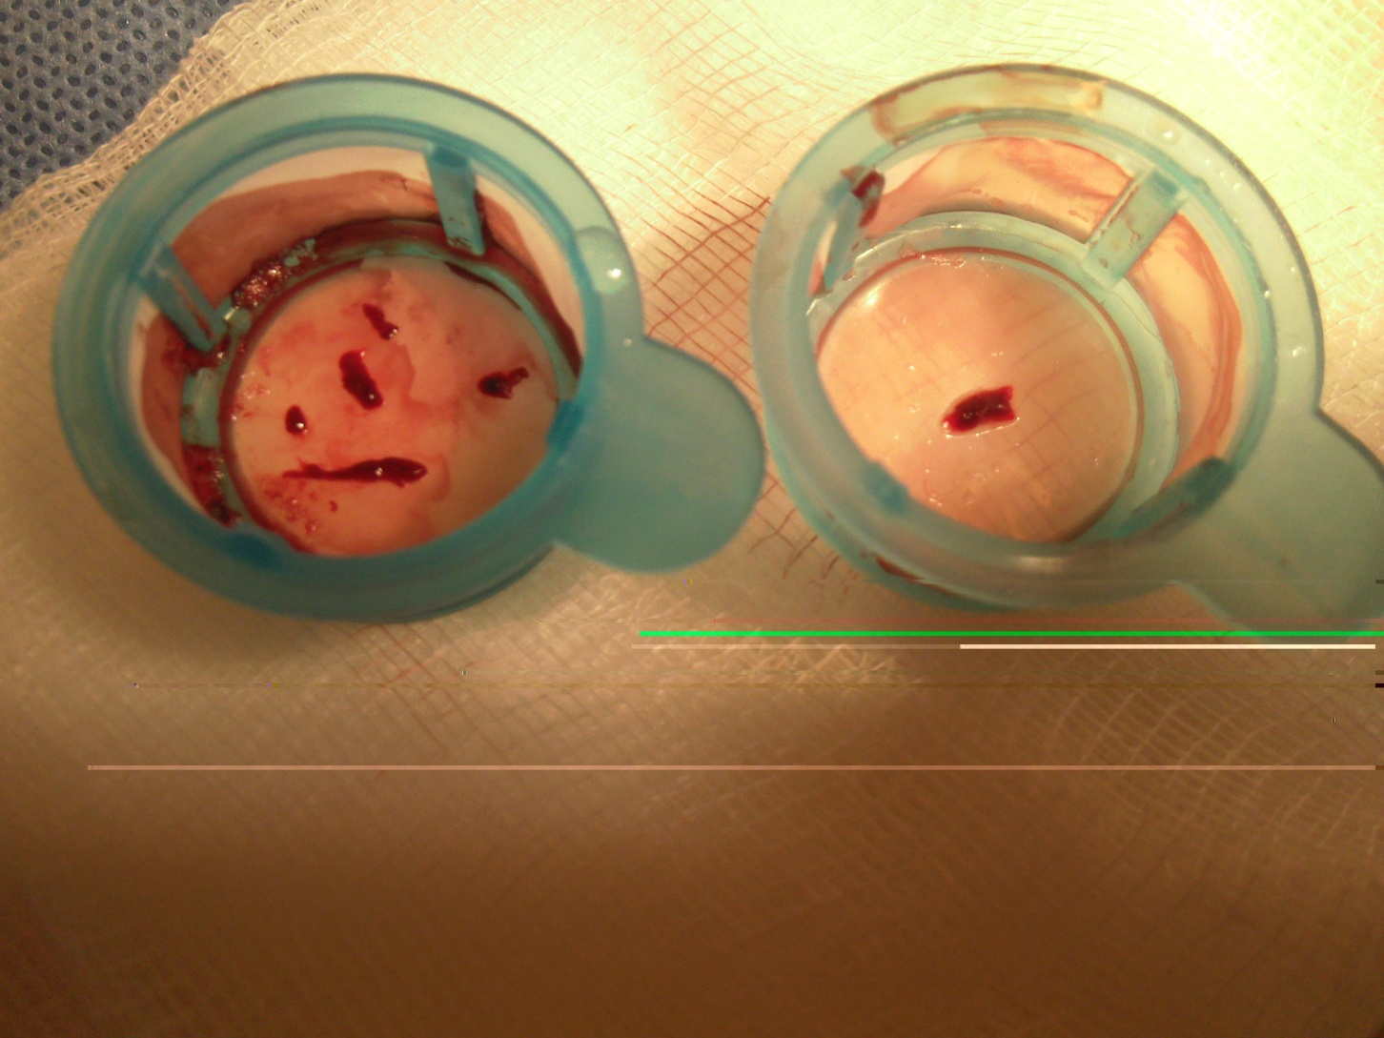
Figure 6. Thrombus aspired with Export system

