Slide 1
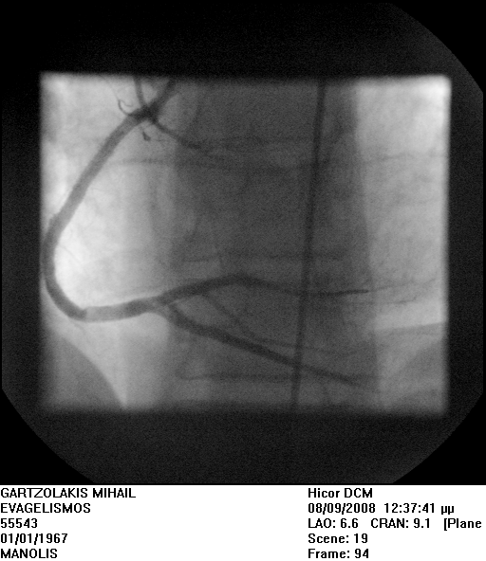
Figure 5. Total occlusion of the right coronary artery and restoration of flow after percutaneous coronary intervention

